Slide 1




American Retail Centre Geographies: Centres, Characteristics & Catchments
Patrick Ballantyne, Alex Singleton, Les Dolega, Jacob Macdonald
AAG Spring 2021 [virtual]
@pj_ballantyne
Notes:
Introduce yourself – Patrick Ballantyne, PhD Student at the Geographic Data Science Lab, University of Liverpool (Large research group, doing all things ‘geographic data science’. Doing lots of stuff with retail centres – including their definitions and applications, but also interested in spatial applications/GIS in R and their wider applications to retail environments.
This presentation – working progress of a paper from my PhD; currently a smaller-scale application (Chicago Metropolitan Area) of some of this work is at a journal (pending feedback). I really hope to obtain some thoughts on what we are trying to do here – presentation of a national set of retail centre agglomerations.
Caveat: not going to talk about catchments yet as we have only recently started conceptualising this, results for NE region only

Slide 2
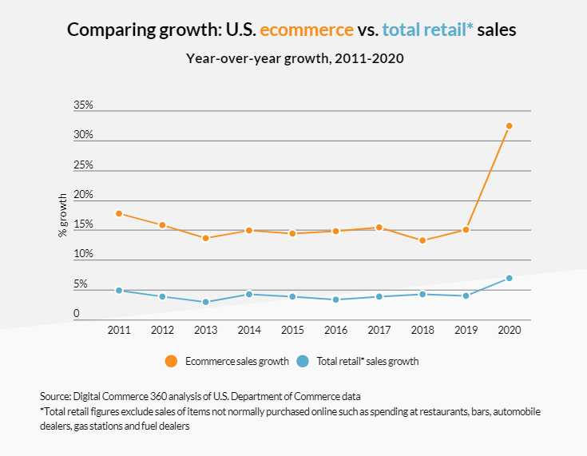
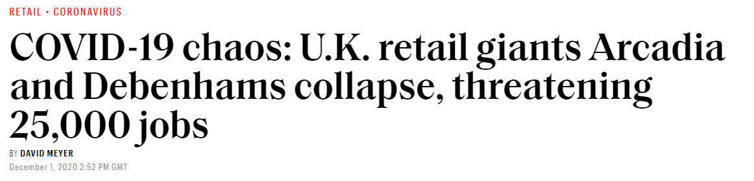
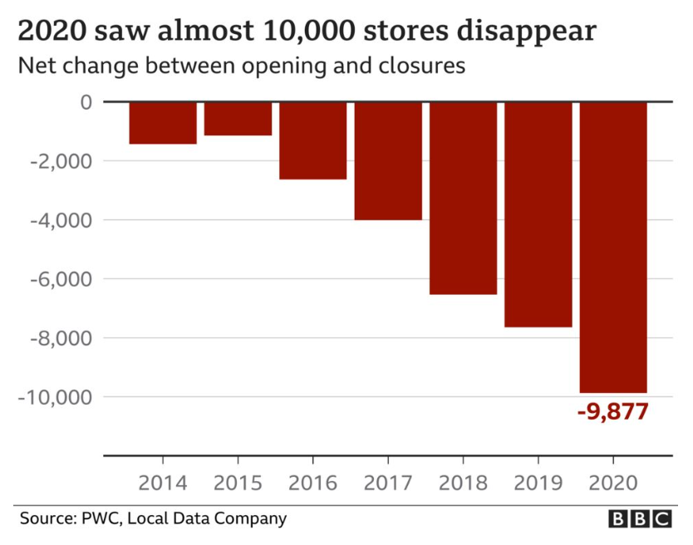

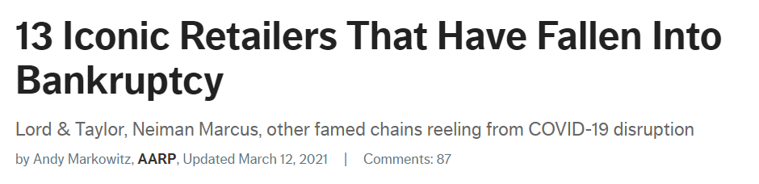
Notes:
As we all know, the retail sector faces many challenges, both in the UK and US:
Increasing uptake of E-commerce
Increasing vacancy rates, and loss of major retail brands/stores that once defined our shopping destinations
Even some evidence that American retail is facing an ‘apocalypse’
COVID-19 – talk about images on screen

Slide 3
We need national tools to understand the dynamics of retail evolution
Notes:
The resulting evolution of retail and its dynamics in the present and future is therefore a pressing issue both for academics in the field of retail/business geographies, but also relevant stakeholders.
There is a need for tools to provide a comprehensive, national insight into how physical retail spaces are responding to these pressures. What I hope will become clear in this presentation is that a national set of retail centre agglomerations for the US could provide such a tool.

Slide 4
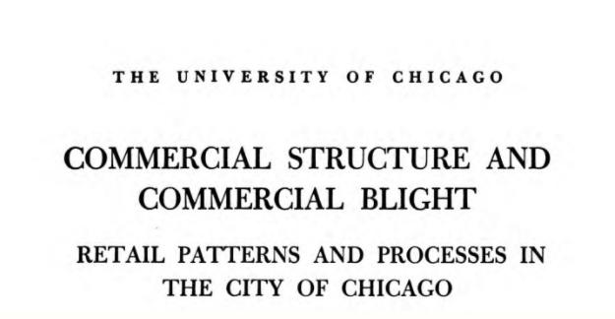
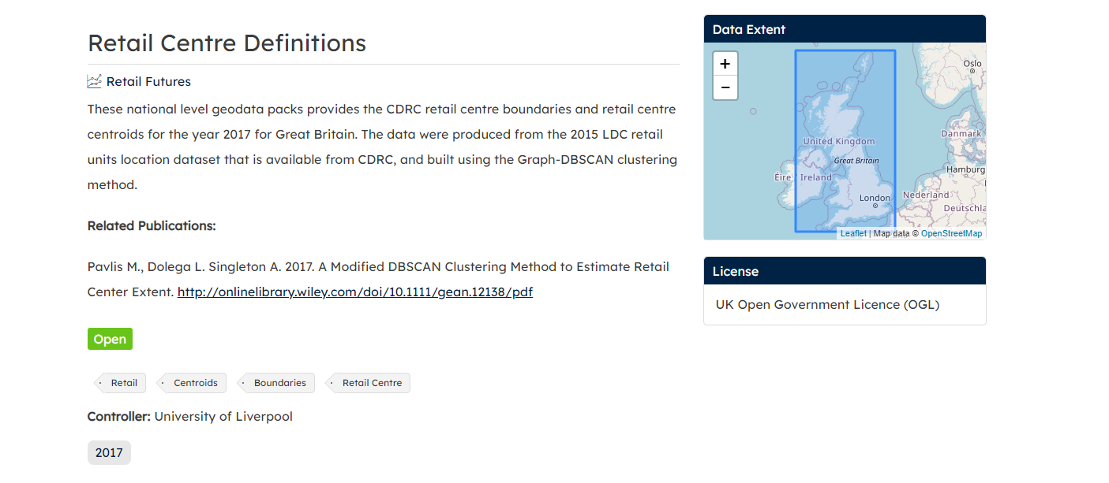
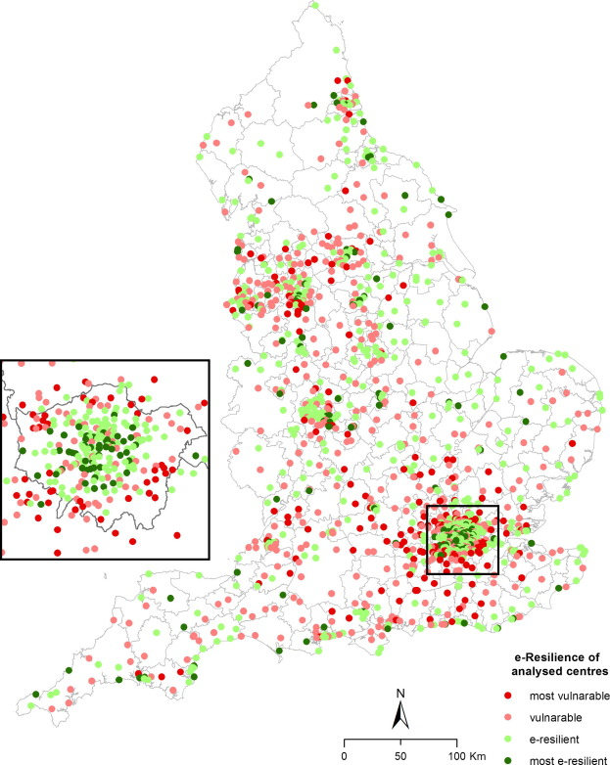
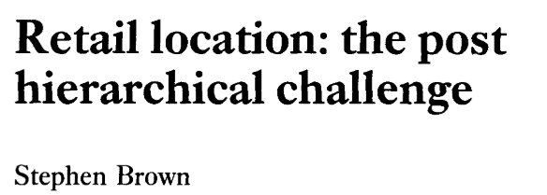

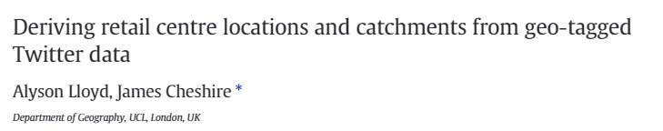
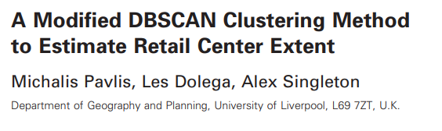
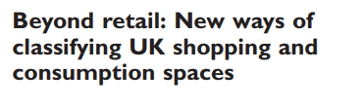
“Concentrations of individual retail units and their associated activities”
Understanding the WHERE and WHAT
Berman and Evans (2013)
Berry (1963))
Brown (1992))
Ballantyne et al. (forthcoming)
Singleton et al. (2016)
Dolega et al. (2019)
Retail Centres – The ‘Place’ of Retailing
@pj_ballantyne
Notes:
There is a history of literature seeking to understand the WHERE and WHAT of retail centre agglomerations:
Two seminal works that distinguished based on Form & Function : Berry (1963) distinguished the geography of retail business centres in Chicago (centres, ribbons, specialised areas), and Brown (1992) in the UK – (Planned/Unplanned Clusters, Linear, Isolated)
Delineation – two examples here from the UK – different datasets, methods etc.
Classification – Dolega et al. (2019) a framework through which to classify retail centre agglomerations – through accounting for the multidimensionality of retail – extending beyond form & function.

Slide 5
American Retail Centre Geographies: Centres, Characteristics & Catchments
@pj_ballantyne

Slide 6
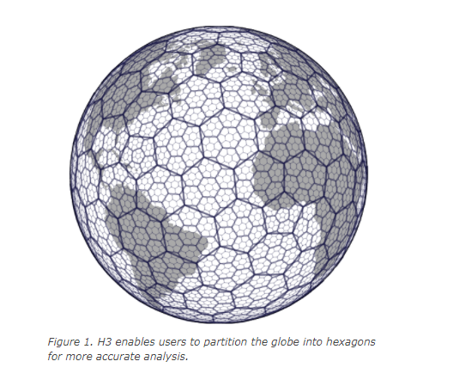

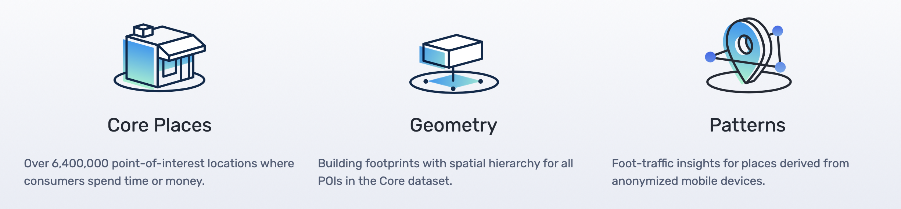

github.com/obrl-soil/h3jsr
@pj_ballantyne
American Retail Centre Geographies: Centres, Characteristics & Catchments
Notes:
Data: SafeGraph – Points (Core Places 3.5 million), Polygons (Building Geometries for the Core Places), extraction of retail-specific places.
Method: Using H3 – Hexagonal spatial index developed by Uber, method is relatively simple, offering advantage over other more complicated methods using spatial clustering

Slide 7
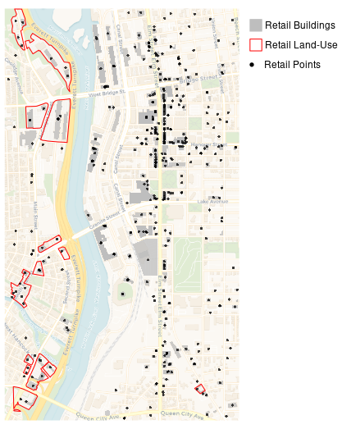
@pj_ballantyne
American Retail Centre Geographies: Centres, Characteristics & Catchments
Notes:
I’m going to walk you through how we build our retail centres – this is the centre of Manchester in NH (just as an example)
So we take as input the points and polygons from SafeGraph – we’ve also included retail land-use polygons from OSM, as this helps us to integrate car parks and full extents of major planned retail developments.

Slide 8
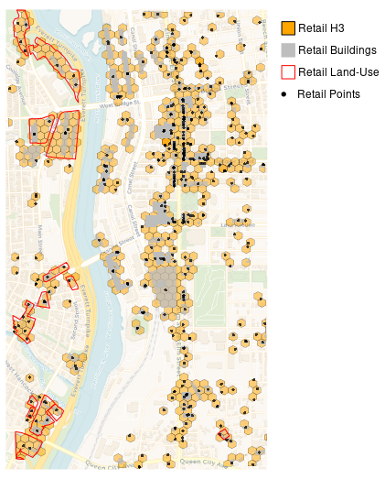
@pj_ballantyne
American Retail Centre Geographies: Centres, Characteristics & Catchments
Notes:
We then aggregate all of these features to a H3 hexagon, creating a grid of hexagons for the area.

Slide 9
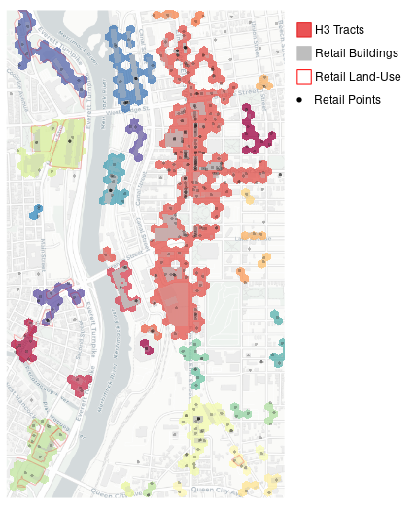
@pj_ballantyne
American Retail Centre Geographies: Centres, Characteristics & Catchments
Notes:
Each of these hexagons has a unique H3 address, and we are then able to identify using some of the neighbouring functions in h3jsr the relationships between each of these unique H3’s.
In this first round we extract tracts of hexagons based on immediate neighbours – i.e. each hexagon must touch another hexagon to be in that tract.

Slide 10
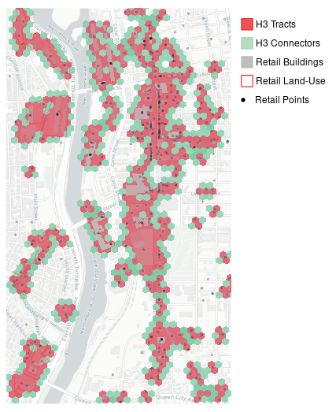
@pj_ballantyne
American Retail Centre Geographies: Centres, Characteristics & Catchments
Notes:
We can then start to look and see if some of these tracts are near to other tracts of retail H3’s – again using the neighbouring functions, we can connect tracts that are one hexagon away from each other.

Slide 11
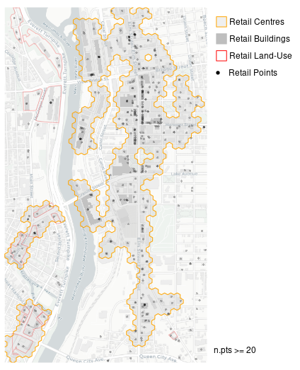
@pj_ballantyne
American Retail Centre Geographies: Centres, Characteristics & Catchments
Notes:
And then we can pull out a final set of retail centre boundaries – some additional caveats for major retail centres, those larger than neighbourhood centres – ICSC (n.pts >= 20)

Slide 12
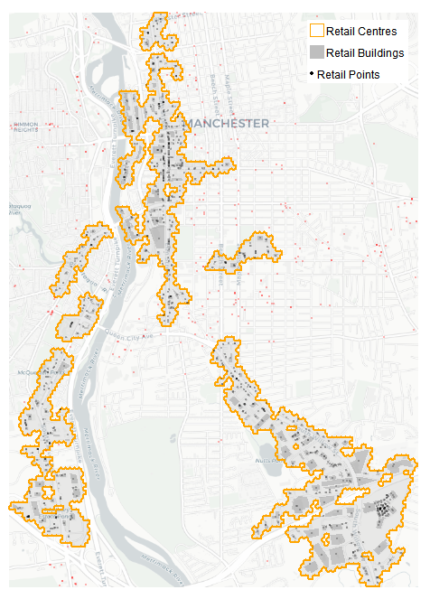
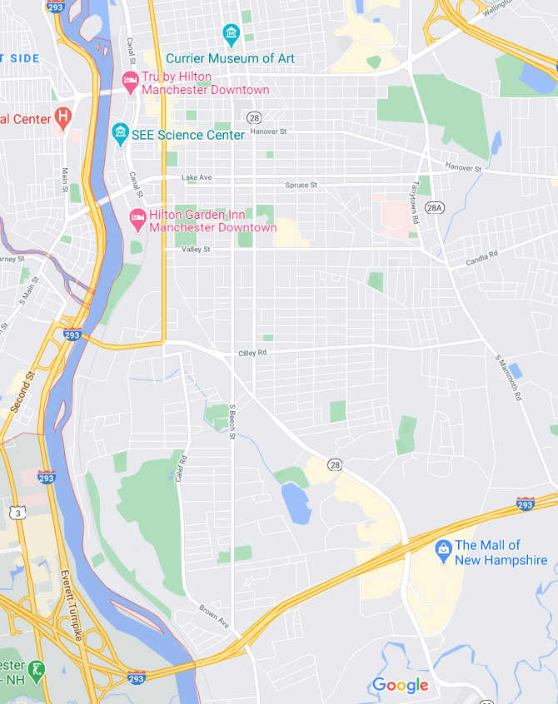
Mall of New Hampshire
@pj_ballantyne
American Retail Centre Geographies: Centres, Characteristics & Catchments

Slide 13
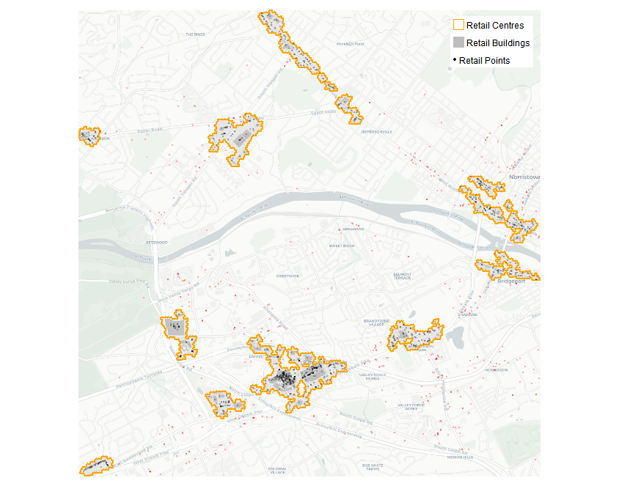
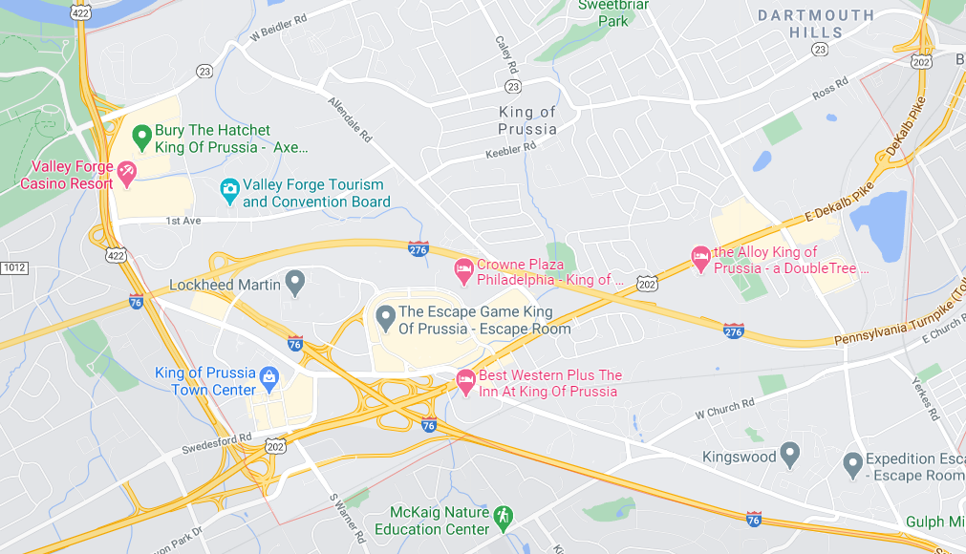
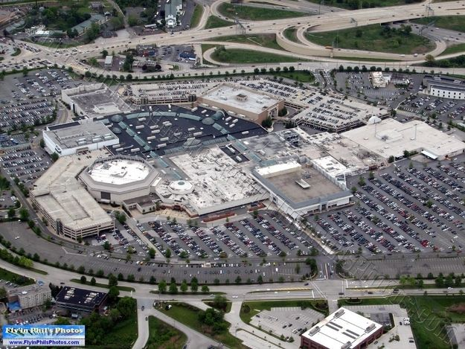
King of Prussia Mall
@pj_ballantyne
American Retail Centre Geographies: Centres, Characteristics & Catchments

Slide 14
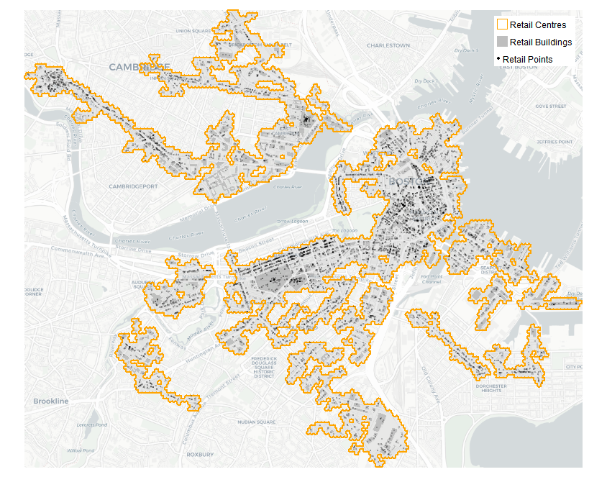
Kendall Square
Boston North/ Financial District
Fort Point
@pj_ballantyne
American Retail Centre Geographies: Centres, Characteristics & Catchments

Slide 15
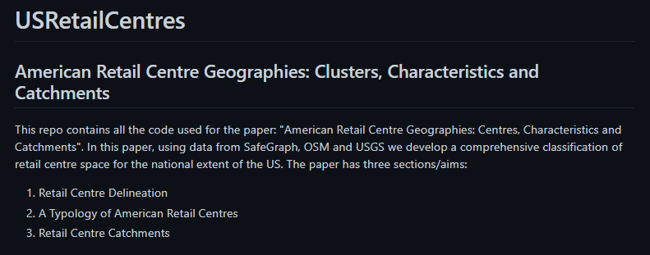

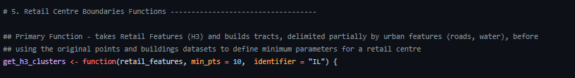
Kendall Square
Boston North/ Financial District
Fort Point
github.com/patrickballantyne/USRetailCentres
@pj_ballantyne
American Retail Centre Geographies: Centres, Characteristics & Catchments

Slide 16
American Retail Centre Geographies: Centres, Characteristics & Catchments
@pj_ballantyne

Slide 17
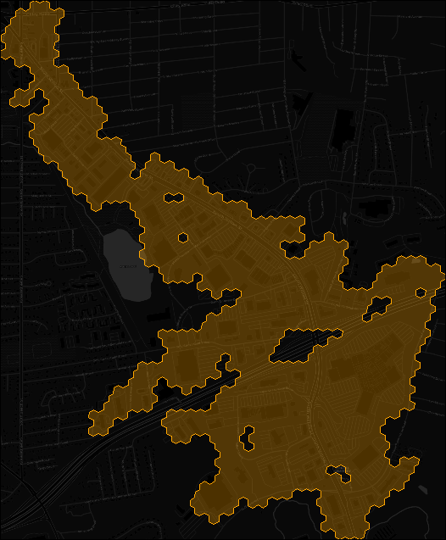
@pj_ballantyne
American Retail Centre Geographies: Centres, Characteristics & Catchments
Notes:
So once we have the retail centres themselves we want to construct a typology that summarises the key differences between them.

Slide 18
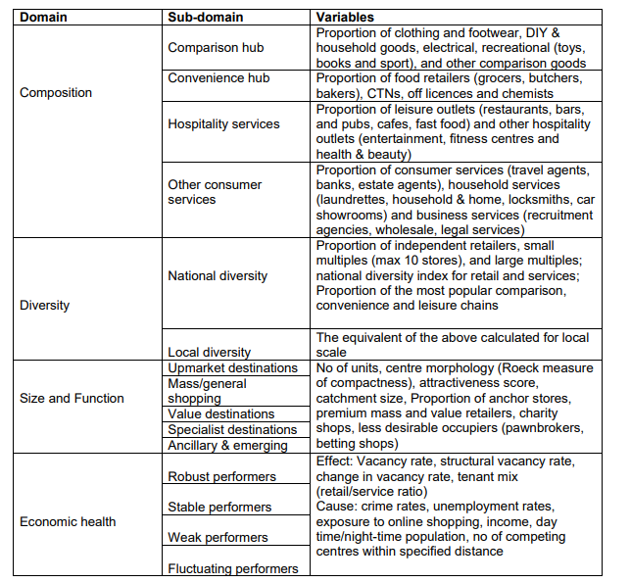
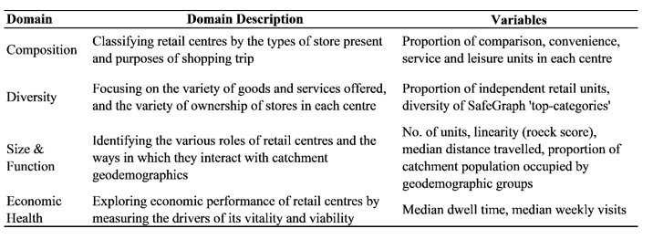
Ballantyne et al. (forthcoming)
Dolega et al. (2019)
@pj_ballantyne
American Retail Centre Geographies: Centres, Characteristics & Catchments
Notes:
To build the typology we have adopted the framework proposed in Dolega et al. (2019)
The paper demonstrated the use of a data-driven approach to retail centre classification, whereby a series of variables were gathered to capture the multidimensionality of retail, and an unsupervised machine learning algorithm was used to identify groups of centres sharing similar characteristics.

Slide 19
Form:
Size, Shape, Density of Buildings and Roads
Composition:
Comparison, Convenience, Service and Leisure Mix
Additional Components:
Geodemographics, Economic Performance
US-Specific:
Density of Buildings & Roads, Retail Employment Densities, Distance to Transit
Diversity:
National Chains vs Independents, Heterogeneity of Retail Categories
Function:
Retail Employment Densities, Distance to Transit
@pj_ballantyne
American Retail Centre Geographies: Centres, Characteristics & Catchments

Slide 20
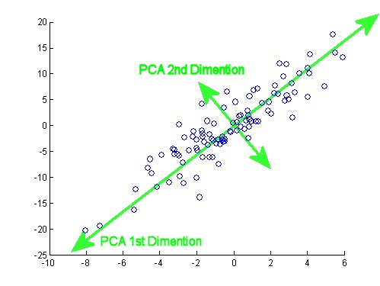
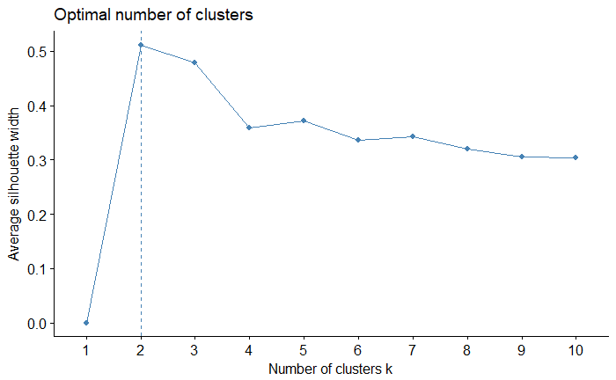
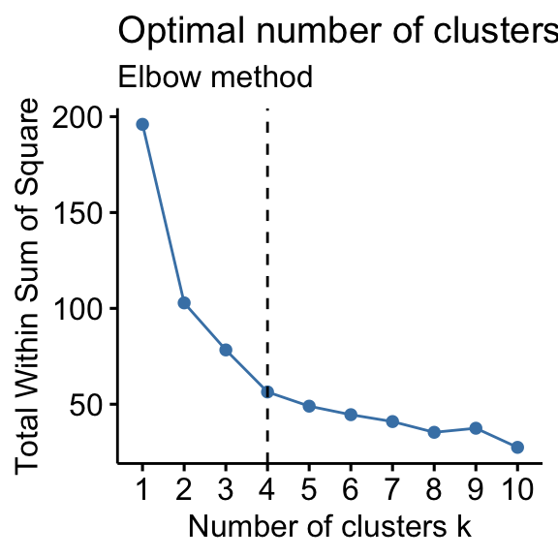
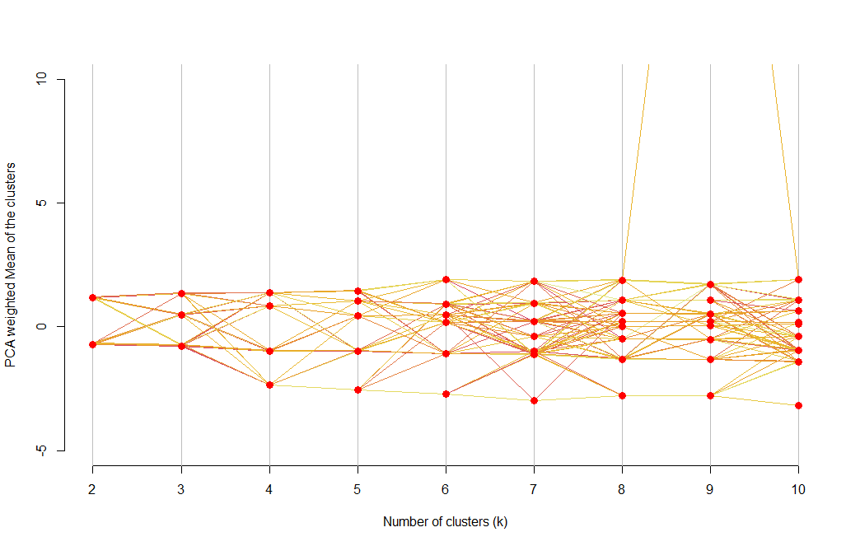
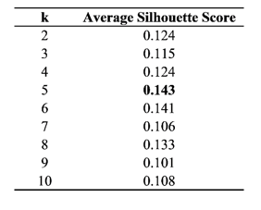
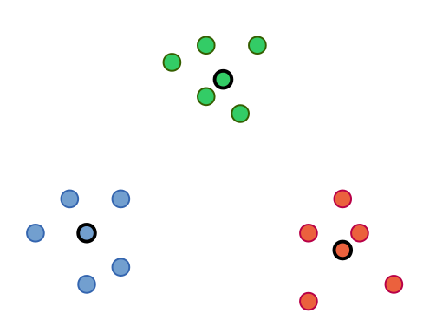
PCA
Choosing k
PAM
@pj_ballantyne
American Retail Centre Geographies: Centres, Characteristics & Catchments
Notes:
Once we have the variables – 30 approx., we can use PAM and PCA to build the classification –
PCA – which variables are most useful for distinguishing between different centres
PAM – throw the variables into the algorithm, identify number of retail centre groups and types… Choosing K!

Slide 21
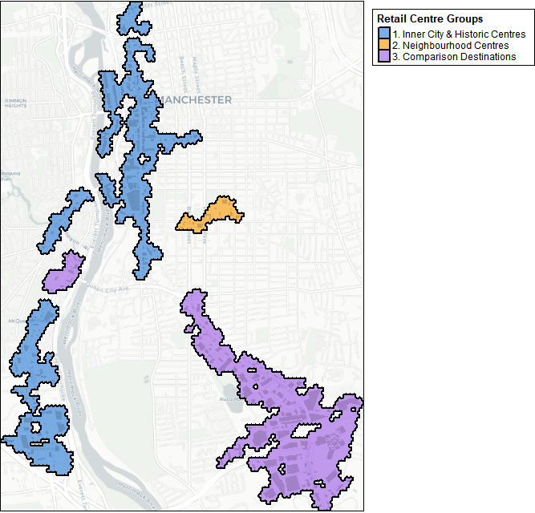
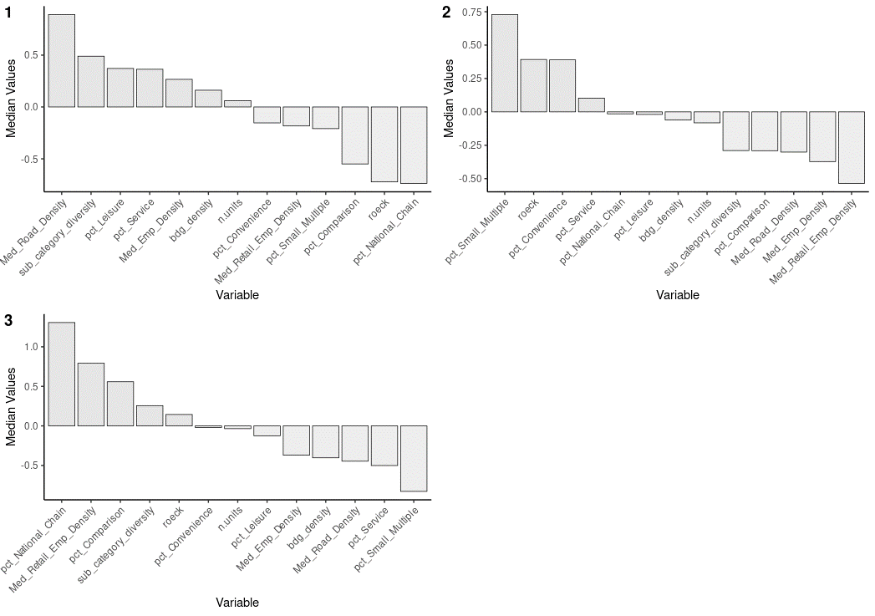
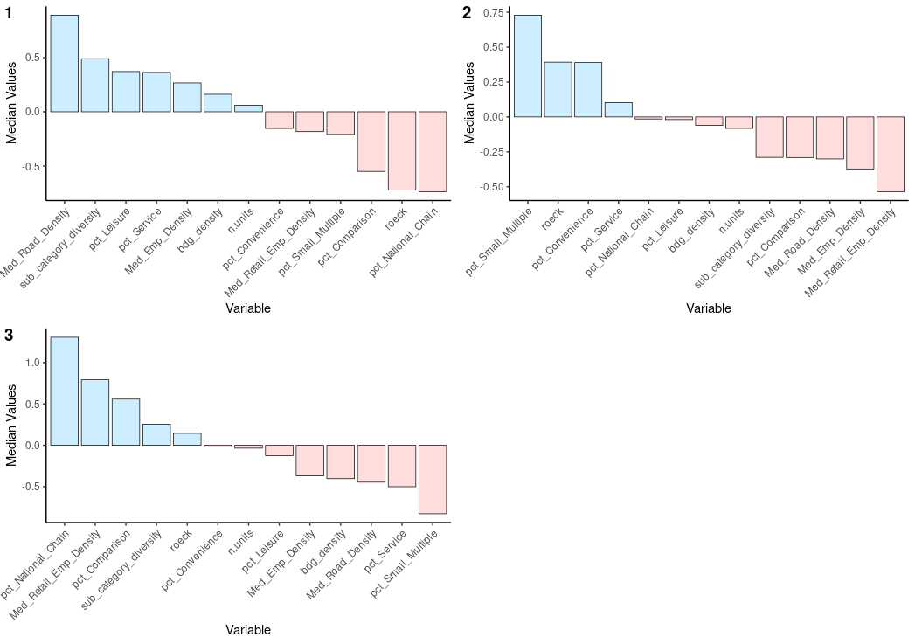
@pj_ballantyne
American Retail Centre Geographies: Centres, Characteristics & Catchments
Notes:
The third group of centres – characteristically the major ‘shopping’ destinations – malls, plazas etc. – retail employment & comparison retail dense, diverse, away from dense urban areas!

Slide 22

github.com/patrickballantyne/USRetailCentres
@pj_ballantyne
American Retail Centre Geographies: Centres, Characteristics & Catchments
Notes:
The third group of centres – characteristically the major ‘shopping’ destinations – malls, plazas etc. – retail employment & comparison retail dense, diverse, away from dense urban areas!

Slide 23
American Retail Centre Geographies: Centres, Characteristics & Catchments
@pj_ballantyne
Slides @ github.com/patrickballantyne/USRetailCentres

Slide 24
American Retail Centre Geographies: Centres, Characteristics & Catchments
Patrick Ballantyne, Alex Singleton, Les Dolega, Jacob Macdonald
Thanks for listening! Questions??
@pj_ballantyne
Slides @ github.com/patrickballantyne/USRetailCentres

